Slide 2
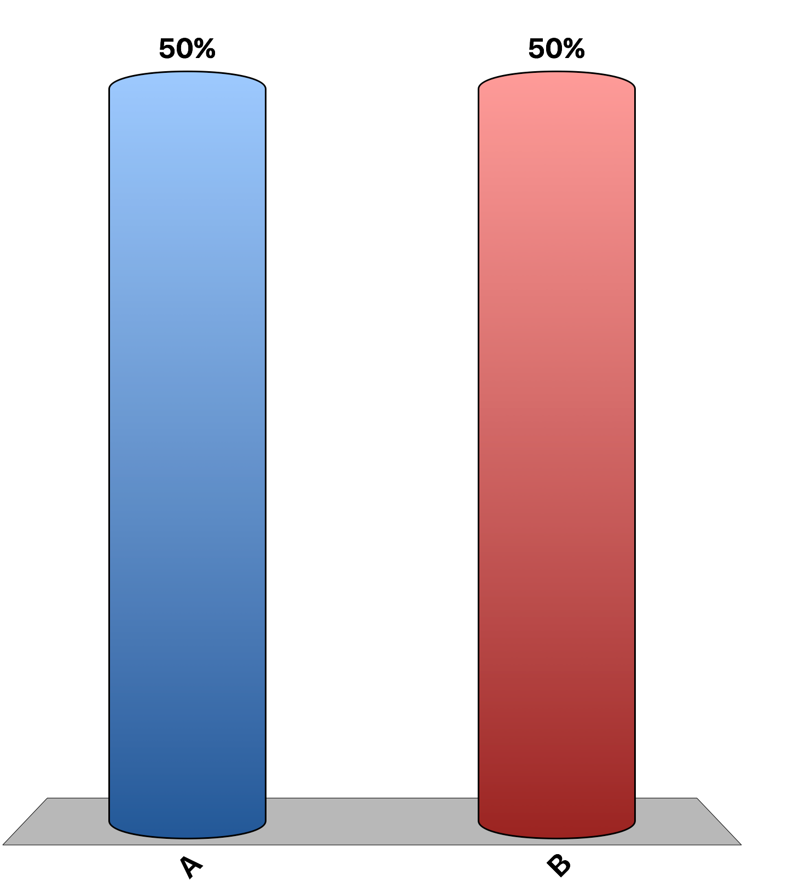
A production possibilities frontier that illustrates the production of cars and computers shows the opportunity cost of computers measured in terms of cars.
True
False
30

Slide 3
A circular flow diagram shows how dollars flow through financial markets among households and firms.
True
False
30

Slide 4
Positive statements are prescriptive and cannot be confirmed or refuted by examining the evidence.
True
False
30

Slide 5
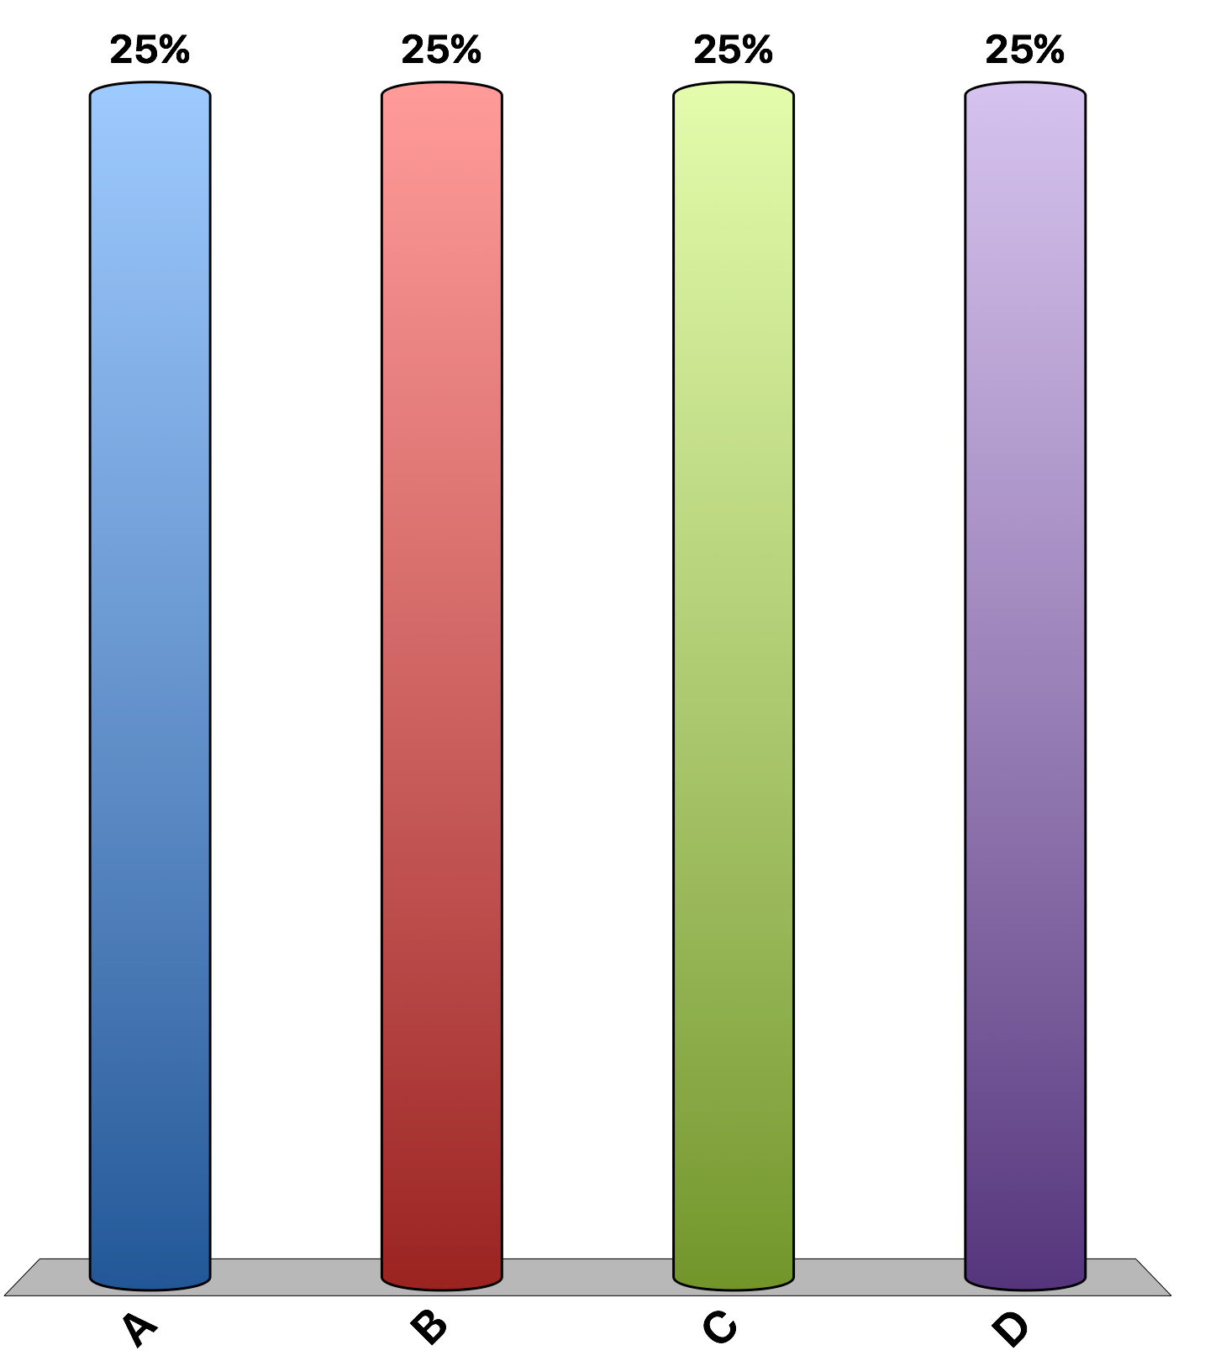
In a circular flow diagram, decisions are made by
Households and firms. Firms are sellers in the markets for goods and services; households are buyers in the markets for goods and services.
Individuals and government. Individuals are sellers in the markets for goods and services; the government is a buyer in the markets for goods and services.
Households and firms. Firms are buyers in the markets for goods and services; households are sellers in the markets for goods and services.
Individuals and government. Individuals are buyers in the markets for goods and services; the government is a seller in the markets for goods and services.
30

Slide 6
Which of the following examples does not correctly describe the movement of $10 through a circular flow diagram?
A firm sells a hat for $10. The firm uses the $10 to hire another employee. The employee uses $10 of her wages to pay her cell phone bill.
An individual works for a firm for $10 per hour editing textbooks. The firm sells a textbook to a consumer.
An individual buys one share of stock for $10. The firm that sold the stock uses the $10 to pay back interest on a loan from the U.S. government’s Small Business Administration (SBA). The SBA uses the $10 to pay one of its employees.
A consumer buys a gourmet sandwich for $10. The owner of the sandwich shop uses the $10 to pay one of her employees. The employee uses $10 of his wages to purchase a book.
30

Slide 7
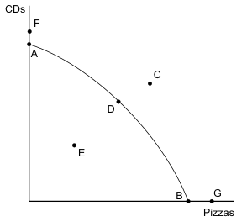
On the production possibilities graph, which points are efficient?
A, B, and D
C, F, and G
E
A, B, F, and G
30

Slide 8
Fruit of the Loom’s production possibilities between “tighty-whities” (T-W's) and boxers: Refer to the Fruit of the Loom's table above. What is the opportunity cost of increasing the production of T-W’s from 0 to 10?
25 boxers
10 boxers
10 T-W’s
25 T-W’s
30

Slide 9
Fruit of the Loom’s production possibilities between “tighty-whities” (T-W's) and boxers: Refer to the Fruit of the Loom's table above. What is the opportunity cost of increasing the production of T-W’s from 20 to 30?
10 boxers
10 T-W’s
20 boxers
20 T-W’s
30

Slide 10
Fruit of the Loom’s production possibilities between “tighty-whities” (T-W's) and boxers: Refer to the Fruit of the Loom's table above. What is the opportunity cost of increasing the production of boxers from 0 to 25?
25 T-W’s
10 T-W’s
25 boxers
10 boxers
30

Slide 11
In the figure above, assume the economy is producing at point D; then a technological innovation is discovered that reduces the production costs of pizza. As a result, the economy would be able to produce more
CDs only.
pizzas only.
more CDs and more pizzas.
more CDs or more pizzas but not more of both.
30

Slide 12
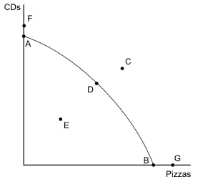
For the production possibilities frontier above, identify which of the following statements is incorrect:
production points A and B are efficient
production points D and E are efficient
production points F and G are unattainable
production point E is inefficient
30

Slide 13
On a production possibilities frontier showing military goods and consumer goods, which of the following is most likely to cause an inward shift of the PPF?
destruction of economic resources because of war
a decrease in society’s preferences for military goods relative to consumer goods
a decrease in society’s preferences for consumer goods relative to military
technological advances in the aerospace industry
30

Slide 14
As we move to the right on a bowed outward production possibilities frontier, we see:
increasing labor productivity
decreasing labor productivity
increasing opportunity cost
decreasing opportunity cost
30

Slide 15
Which of the following topics falls within the study of macroeconomics?
your neighbor's decision about how much to save for their vacation
a firm's decision about how much output to produce
the effects of borrowing by the federal government
the effects of rent control on housing in Chicago
30

Slide 16
Which of the following illustrates a positive statement followed by a normative statement?
The government should raise the minimum wage. Minimum-wage laws cause teenage unemployment.
More people in the United States should vote in the next Presidential election. Non-U.S. citizens should be allowed to vote in U.S. Presidential elections.
The Earned Income Tax Credit benefits the working poor. The government should expand the Earned Income Tax Credit.
Temporary tariffs protect domestic steel producers. Import quotas protect domestic farmers.
30

Slide 17
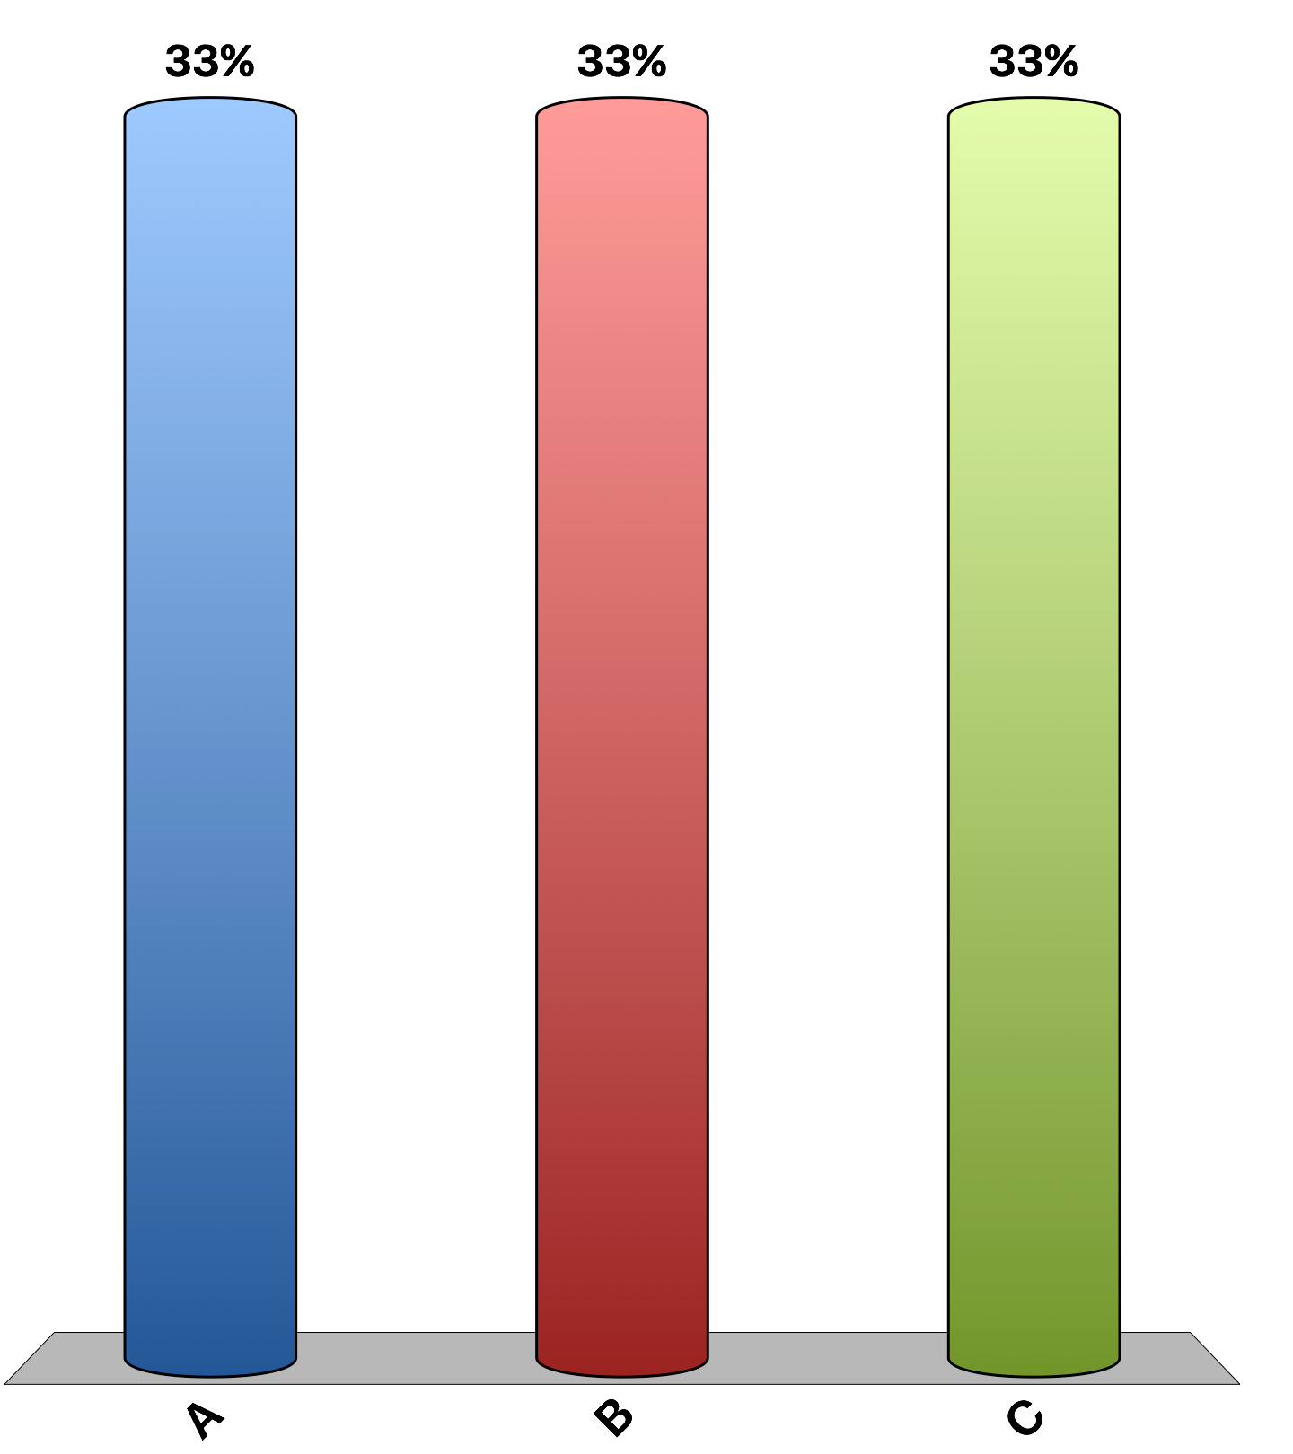
“Laws that limit the resale of tickets for entertainment and sports events make potential audience members for those events worse off on average.”
agree
disagree
uncertain
30
Notes:
About 80% of economists agree, 8% disagree, and 12% are uncertain. This is the 'Ask the experts' feature in the textbook. Source: IGM Economic Experts Panel, April 16, 2012.

